Slide 1
FACULTY OF ENGINEERING
MATLAB ASSIGNMENT ONE AND TWO GROUP 5 PRESENTATION
Presented To: Maseruka Benedicto
Course: Computer Programming
Date of submission: 23rd September, 2025.

Slide 2
GROUP MEMBERS
Name | Registration Number | Course
Kemigisha Tasha Caroline | BU/UG/2024/5056 | AMI
Ayebare Prudence | BU/UP/2024/1022 | WAR
Kenyi Moses | BU/UP/2024/5344 | MEB
Zzimbe Enock | BU/UP/2024/4455 | WAR
Oketch Simon | BU/UP/2024/0841 | AMI
Nakyagaba Barbra | BU/UP/2024/4328 | APE
Kabugiri Pearl Flavia | BU/UP/2024/4450 | WAR
Omali Emmanuel | BU/UP/2024/1O62 | WAR
Oyugi Andrew Linus | BU/UP/2024/1068 | WAR
Kagoya Ann Lauriene | BU/UP/2024/0996 | PTI
Group 5 Members

Slide 3
Introduction and project overview
INTRODUCTION
Objective: To demonstrate the application of MATLAB programming concepts from module 1 to 4.
Team work: Collaborated in the university library to discuss, research, and develop solutions.
Assignments
Assignment 1: Data handling, structuring, and visualization from a real-world dataset (Life Expectancy)
Assignment 2: Data collection, storage, and statistical analysis of group member attributes.

Slide 4
ASSIGNEMNT ONE-OBJECTIVES
Assignment 1: DATA ANAYSIS AND VISUALIZATION
Part A: Data Handling
Retrieve a unique Excel dataset from Kaggle
Read data into MATLAB
Organize data into tables and structural arrays by year.
Export each year’s data to separate sheet in a new Excel file.
Part B: Data Visualization.
create various plots to show patterns, trends, and relationships.
Ensure all plots are well-labelled and saved as image files.

Slide 5
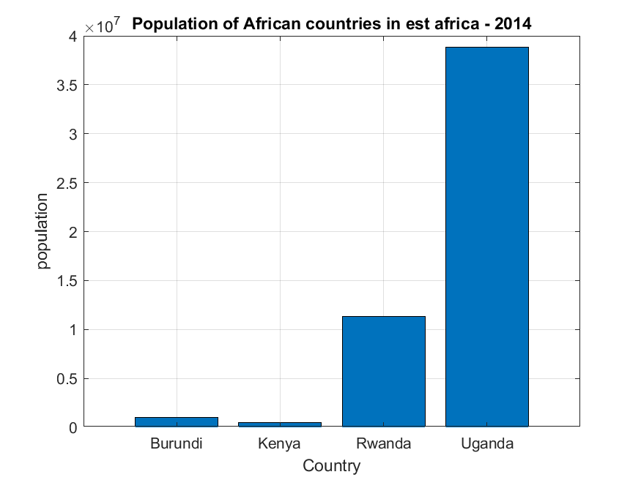
DATA ANAYSIS AND VISUALIZATION

Slide 6
ASSIGNMENT 1- METHODOLOGY AND CODE SNAPSHOT (Part A).
METHODOLOGY (PART A)
Used readtable( ) to import the Excel data
Employed a for loop to iterate through unique years.
Created a structural array (struct) to store data for each year dynamically.
Used writetable( ) to output each year’s data to separate sheet.
Code Snippet
data_set = readtable(‘life.xlsx’);
Years = unique(data_set.Year);
For I = 1:length(years)
yearly_data = data_set(data_set.Year == years(i), :);
Writetable(yearly_data, ‘output.xlsx’, ‘sheet’ , num2str(years(i)));
end

Slide 7
ASSIGNMENT 1- KEY VISUALIZATION PART(B)
VISUALIZATION CREATED.
Scatter plot: Population of East African Countries (2010)
Bar Chart: Population of East African Countries (2014)
Pie chart: Alcohol consumption in East Africa (2008)
Correlation Heatmap: Relationships between variables like Life Expectancy, GDP, etc. (2012)
3D Scatter Plot: Life Expectancy vs. GDP and alcohol Consumption (2003)

Slide 8
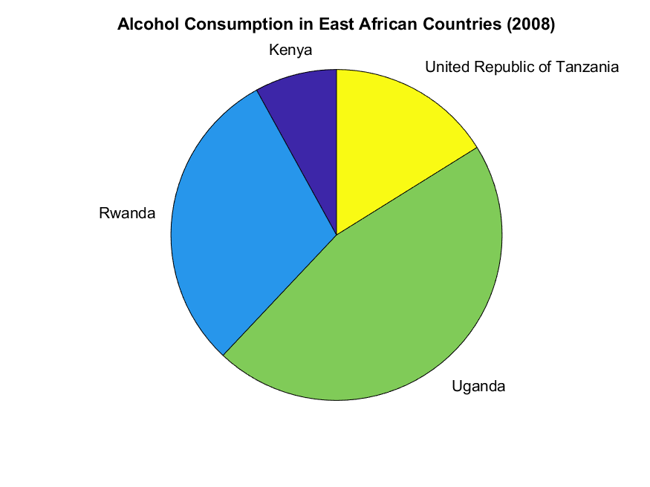
KEY VISUALIZATION PART(B)
Pie chart showing alcohol consumption

Slide 9
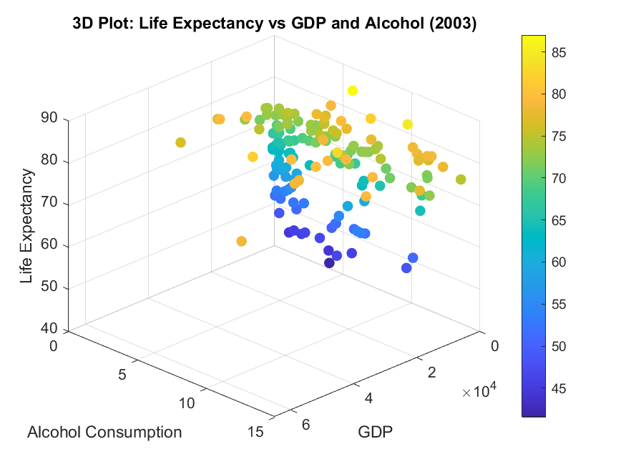
KEY VISUALIZATION PART(B)
Diagram representation of the 3D scatter plots

Slide 10
SAMPLE RESULTS (IMAGES)
SAMPLE VISUALIZATIONS
(insert the generated images here side-by side or one by one)
Image1:
life_expectancy_vs_gdp_2010.png
Image2
EastAfrica_Population_2014.png
Image3: HeatMap_2012.png
The heatmap allowed us to quickly identify strong correlations between health and economic factors

Slide 11
SAMPLE VISUALIZATIONS(IMAGES)

Slide 12
ASSIGNMENT 2- OBJECTIVES
GROUP DATA ANALYSIS
Part A: Data Storage
Write a MATLAB code to store each member’s attributes into a single variable.
Save the variable
Part B: Statistical Description and Visualization.
Use statistical methods to describe the collected data.
Visualize the different attributes to understand the group’s composition.

Slide 13
ASSIGNMENT 2-METHODOLOGY AND CODE SNAPSHOT
METHODOLOGY (PART A)
Used a structural array(struct) to store each member’s information as a record.
Attributes stored: Name, District, Age, Course, Village, Tribe, Religion, Interest, Facial Representation.
Code snippet
members = struct(‘Name’, { }, ‘HomeDistrict’ , { }, ‘Age’, { }, …);
Members(1).Name = ‘KemigisaTasha’;
Members(1).HomeDistrict = ‘Kampala’;
Members(1).Age = 19;
%... Continued for all members.

Slide 14
VISUALIZATION CREATED (PART B)
Histogram: Age distribution of group members.
Bar charts: Distribution of interests and religions
Pie chart: Distribution of tribes within the group
3D Bar Plots:
Tribe vs Interests
Tribe vs. Religion
5. Box Plot: District vs. Age comparison

Slide 15
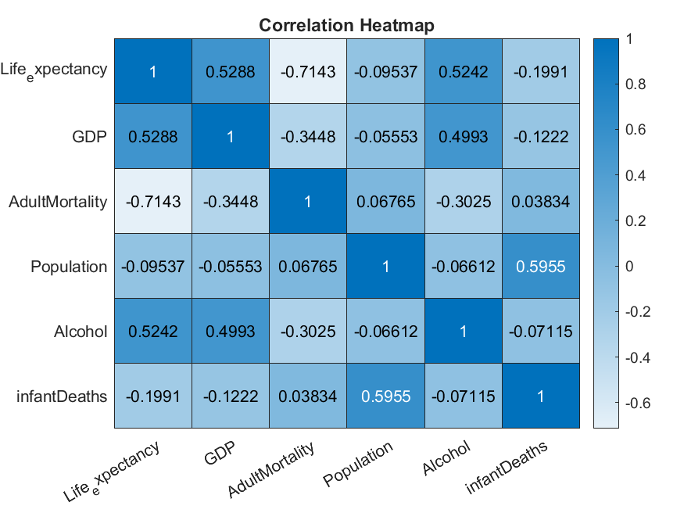
VISUALIZATION CREATED
Correlation Heatmap representation

Slide 16
SAMPLE RESULTS (charts)
SAMPLE VISUALIZATION.
Chart 1: Age Distribution Histogram
Chart 2: Interests Bar Chart
Chart 3: Tribe Distribution Pie Chart.
The visualizations provide a clear demographic and interest profile of Group 5, showing diversity in age, tribe, and interests.

Slide 17
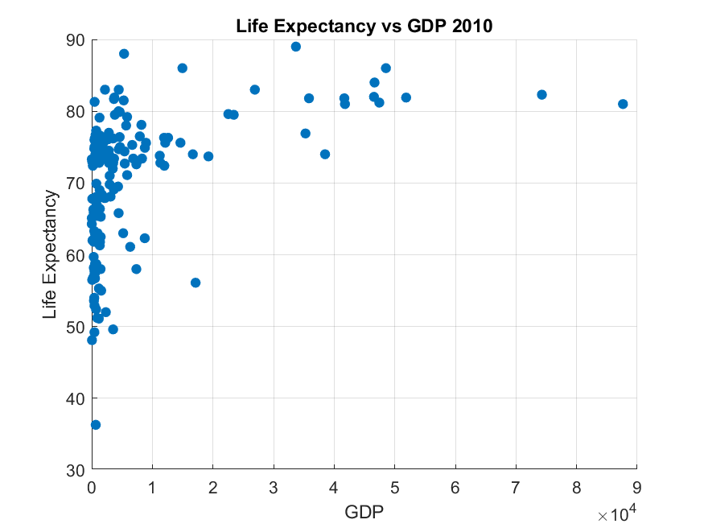
SAMPLE RESULTS (charts)

Slide 18
CHALLENGES SND LESSONS LEARNED
Challenges
Coordinating schedules for group meetings
Ensuring consistent data format (e.g., converting strings to numbers).
Managing file paths for reading/writing data.
Lessons learned:
Strengthened understanding of data structures in MATLAB (tables, structs)
Improved skills in data visualization and plot customization
Enhanced teamwork and collaborative problem-solving

Slide 19
CONCLUSION
Successfully applied MATLAB programming concepts to solve two distinct problems
Both assignments were successfully completed, applying knowledge from Modules 1 to 4.
Assignment 1 focused on external dataset manipulation and visualization
Assignment 2 focused on creating, analyzing, and visualizing a custom dataset.
Overall achievement: The project significantly boosted the group’s practical skills in MATLAB for engineering applications.

